Slide 1
Performing Uncertainty Quantification in Kinetic Plasma Physics Models Using Sparse Grid Surrogates – Update 5/14/2020
P
Presenter: Evan Shapiro
Advisor: Dr. Varis Carey
Committee: Dr. Varis Carey, Dr. Mark Golkowsi, Dr. Amy Roberts
Department: Department of Integrated Sciences at CU Denver

Slide 2
Review
In order to predict the power confinement properties and net fusion particle transport of future scale tokamak fusion reactors in working scenarios, first principle kinetic plasma simulations have been developed.
The inputs to these simulations are experimentally derived, and thus have associate uncertainty.
The simulations are too computationally expensive to run enough simulations to characterize an output QOI well i.e. Sample Mean Kinetic Energy, mean particle flux at a fixed radial distance, and at a fixed time point, within the tokamak.
Sparse grid surrogate models constructed with interpolating basis functions may provide a computationally feasible alternative to the high fidelity simulation. Once constructed can potentially replace full fidelity simulation entirely.
To familiarize myself with the forward UQ workflow and sparse grid construction, and to test the feasibility of this idea before working blindly on a computationally expensive data-set, I incorporated a Landau damping simulation in a 2-D phase space into a UQ workflow algorithm.

Slide 3
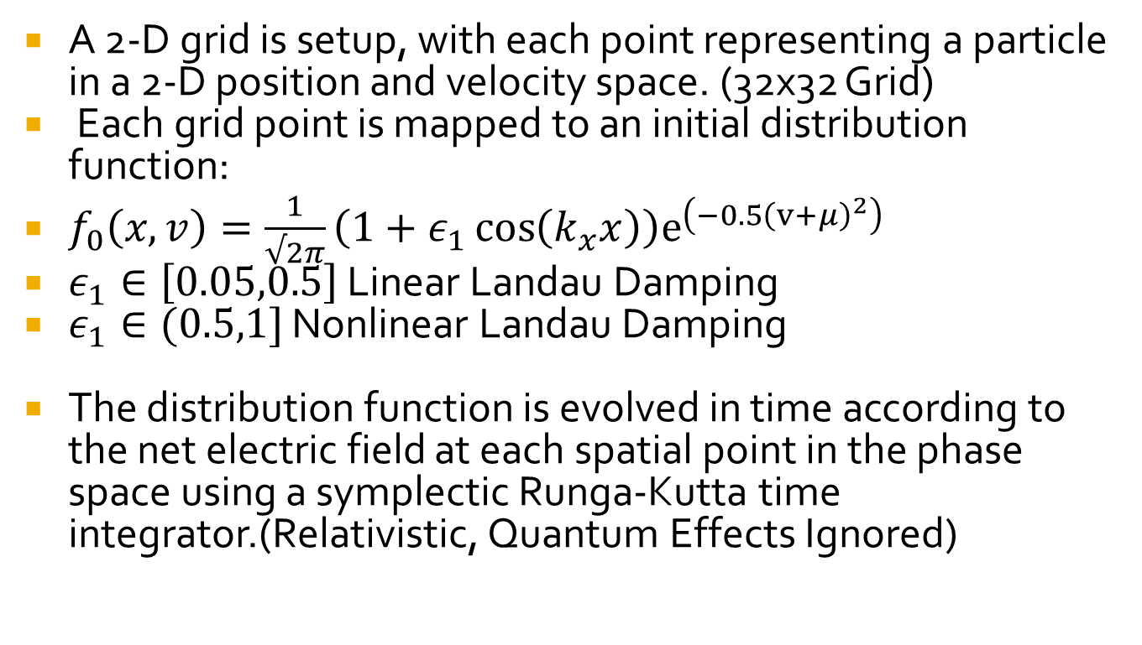
Simulation
A 2-D grid is setup, with each point representing a particle in a 2-D position and velocity space. (32x32 Grid)
Each grid point is mapped to an initial distribution function:
$f_{0}\left(x,v\right)=\frac{1}{√2π}\left(1+ε_{1}\cos\left(k_{x}x\right)\right)e^{\left(−0.5{\left(v+μ\right)}^{2}\right)}$
$ε_{1}∈\left[0.05,0.5\right]$ Linear Landau Damping
$ε_{1}∈(0.5,1]$ Nonlinear Landau Damping
The distribution function is evolved in time according to the net electric field at each spatial point in the phase space using a symplectic Runga-Kutta time integrator.(Relativistic, Quantum Effects Ignored)

Slide 4
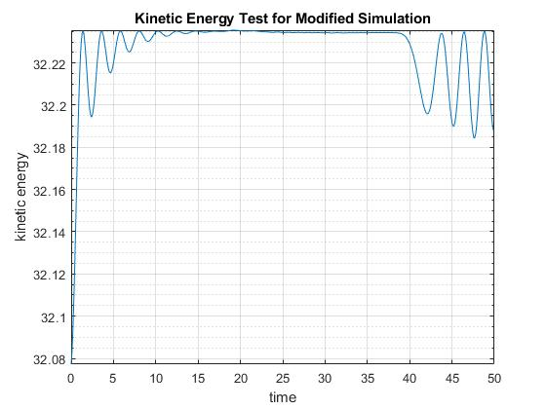
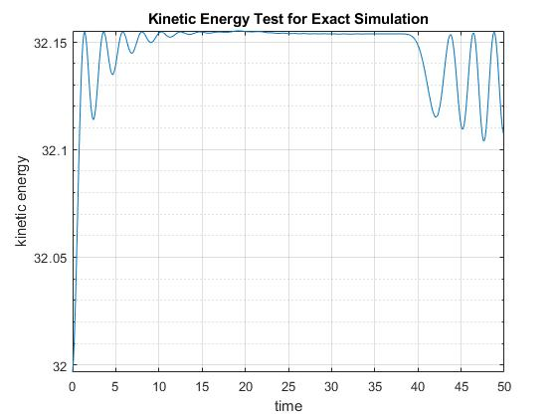
Landau Damping Simulation Results

Slide 5
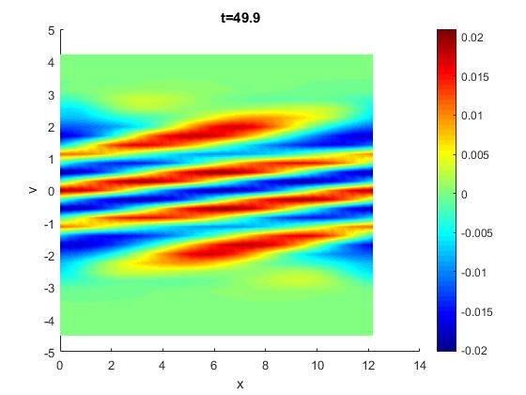

Distribution $f\left(x,v\right)$at 49.9s

Slide 6
Conditions To Be Met
1. Complete post-processing of data from Monte Carlo Simulations and compare with statistics generated from the surrogate model for the 2D Landau damping model. Completed
Constructed kernel density estimate using simulated data from both MC simulation and sparse grid interpolant.
Determined K-L Divergence.
Made MSE comparison of MKE_400 MC and SGS.
3. Write up the results of (1) and (2) in more detail than the current draft of the report, and motivate the use of the surrogate model to other important problems in plasma physics. Completed – On Github.

Slide 7
Conditions To Be Met
2. Compare parameter space predictions from the surrogate model with high-fidelity, overkill solutions to the 2D Landau damping model.
Attempted to make a comparison, however when increasing grid size we increase the number of particles, which increases overall kinetic energy, so a direct comparison of mean kinetic energy is not possible with the chosen QOI.

Slide 8
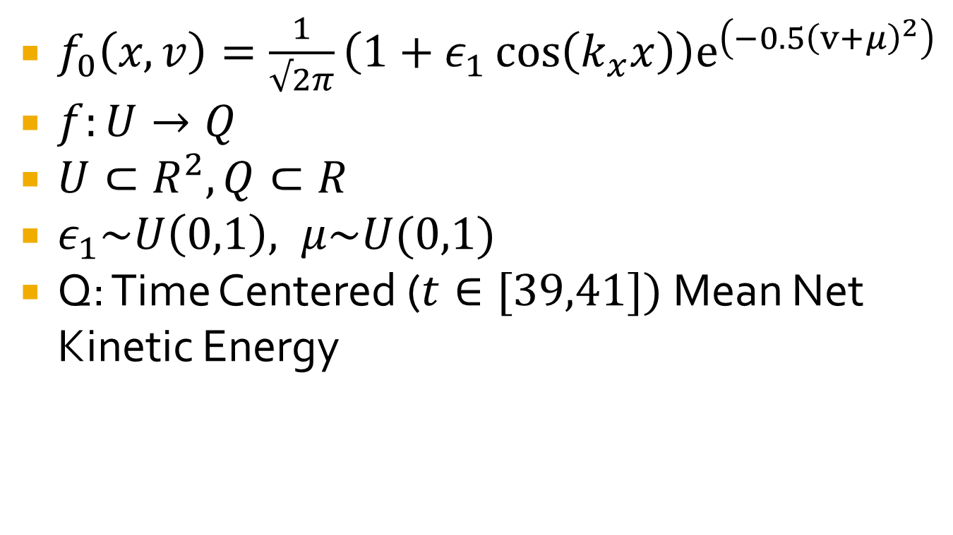
Methodology –Parameter Space &Quantity of Interest Selection
$f_{0}\left(x,v\right)=\frac{1}{√2π}\left(1+ε_{1}\cos\left(k_{x}x\right)\right)e^{\left(−0.5{\left(v+μ\right)}^{2}\right)}$
$f:U→Q$
$U⊂R^{2},Q⊂R$
$ε_{1}\sim U\left(0,1\right), μ\sim U(0,1)$
Q: Time Centered ($t∈[39,41])$ Mean Net Kinetic Energy

Slide 9
Methodology – Monte Carlo Simulations
Monte Carlo DNS – Sample 10000 Parameter Space Pairs and Run Through Simulation. (Consider this truth)
Create QOI Vector for Comparison Against SGS Results.
Also run MC simulation with number of points corresponding to number of sparse grid points for each level for less refined comparison.

Slide 10
Methodology – Sparse Grid Construction
Used Sparse Grid ++ Matlab Code –(Note: Buggy, Poor Documentation.*)
Created 2-D, Levels 1-7 sparse grid surrogates, with 5th degree polynomial interpolating functions.**
Evaluated QOI vector on each surrogate model. (Prediction evalution)
Reminder, Increasing SG Level Increase Number of Grid Points.
Notes:
If I were to continue this I would want to work with SG++ team to improve documentation and improve functionality of Clenshaw-Curtis SG construction.
** Create a sparse grid, and then run grid points through simulation, use results as the interpolating values.

Slide 11
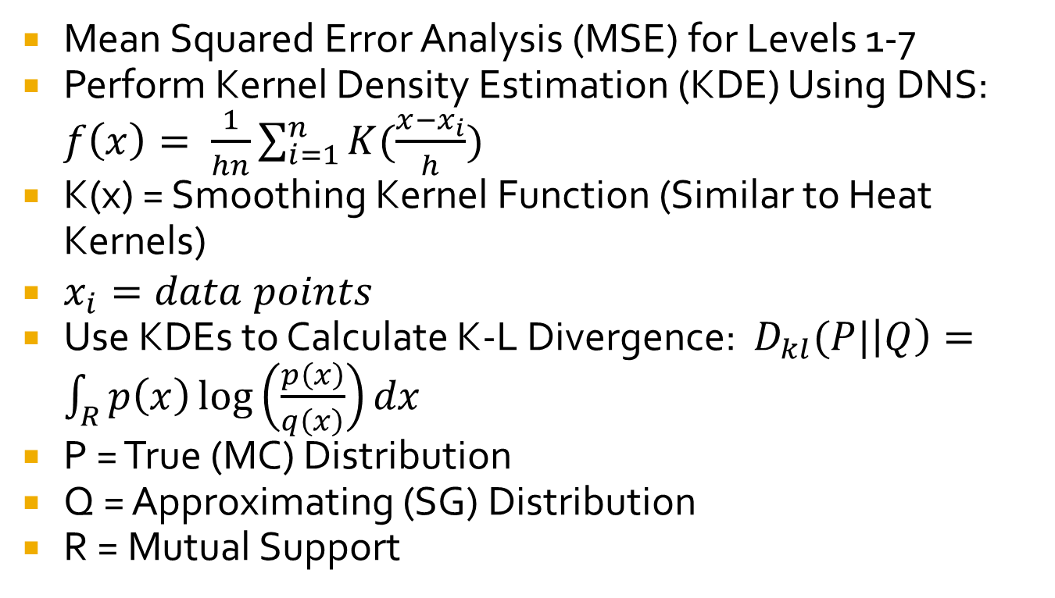
Methodology - Analysis
Mean Squared Error Analysis (MSE) for Levels 1-7
Perform Kernel Density Estimation (KDE) Using DNS: $f\left(x\right)= \frac{1}{hn}\sum_{i=1}^{n}{K(\frac{x−x_{i}}{h})}$
K(x) = Smoothing Kernel Function (Similar to Heat Kernels)
$x_{i}=data points$
Use KDEs to Calculate K-L Divergence: $D_{kl}(P|\left|Q\right)=\int_{R}{p\left(x\right)\log\left(\frac{p\left(x\right)}{q\left(x\right)}\right)dx}$
P = True (MC) Distribution
Q = Approximating (SG) Distribution
R = Mutual Support

Slide 12
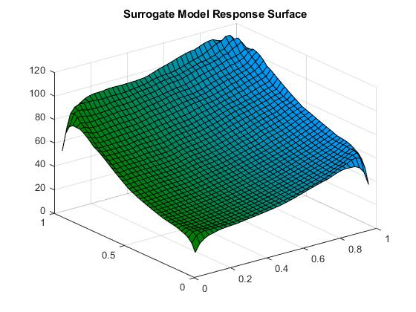
Response Surface – Level 7 SG, 5th Degree Polynomial Interpolating Function

Slide 13
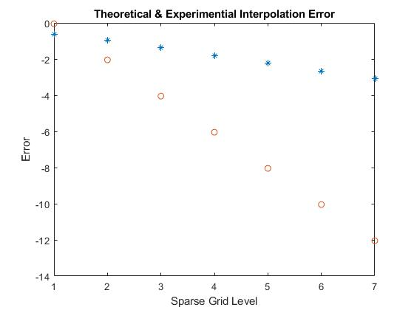
Analysis – Log-MSE Convergence
Log-MSE Convergence Comparison Plot – Theoretical Vs Experimental
Convergence Rate is Much Less than Expected Slop ~ -0.2 rather than -2.

Slide 14
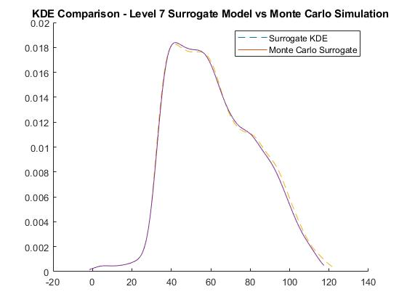
Analysis – Kernel Density Estimation & K-L Divergence
MC & Level 7 SG KDE Comparison With 10,000 Sample Points
K-L Divergence = 0.0091

Slide 15
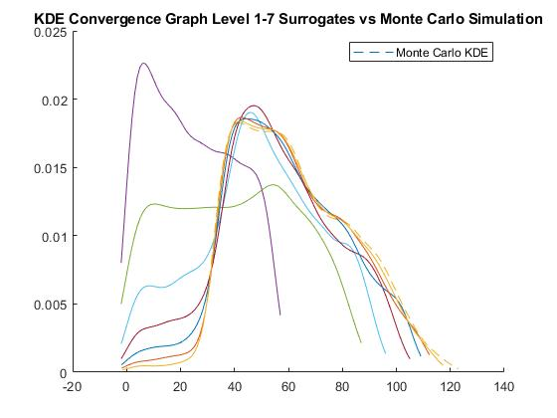
Analysis - KDE Convergence
MC & Levels 1-7 SG KDE Comparison With 10,000 Sample Points

Slide 16
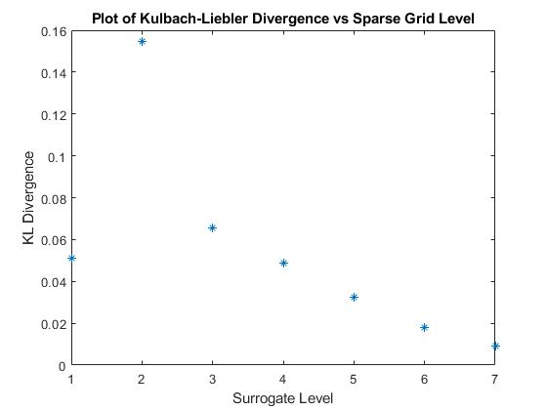
Analysis – K-L Divergence Convergence – Grid Level

Slide 17
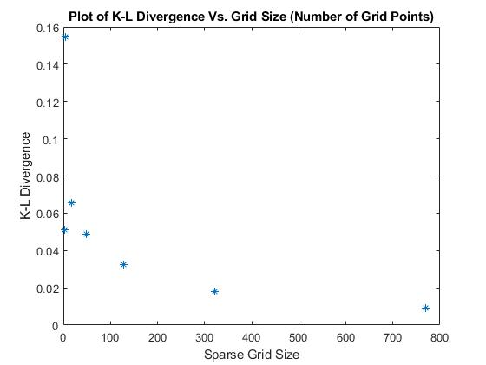
Analysis-K-L Divergence Convergence Grid Size
K-L Divergence Vs Grid Size
K-L Divergence Decreases Exponentially W Grid Size (except for 2nd level sparse grid)

Slide 18
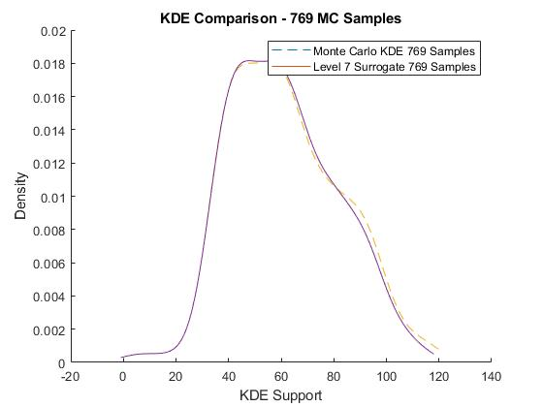
Analysis – KDE Comparison Redux (Fewer Points)
MC & Level 7 SG KDE Comparison With 769 Sample Points
K-L Divergence = 0.0094

Slide 19
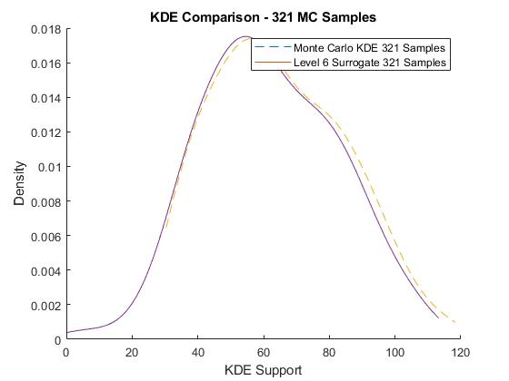
Analysis – KDE Comparison Redux (Fewer Points)

Slide 20
Results & Conclusions and Next Steps
We have demonstrated that we can construct a surrogate model to the Landau damping model using sparse grid interpolation.
With high enough sparse grid level, KDEs (enough grid points) converge to DNS KDE.
Pointwise predictions also converge, slowly. Need to determine cause of slow convergence.
We can potentially use sparse grid surrogate models to replace computationally expensive components of high fidelity transport simulations, with a well defined accuracy now, and pointwise error estimation.
Work with XGC1 results to construct a sparse grid surrogate model.
Work with SG++ team to fix inconsistencies in software and lack of documentation.
Port to Python, turn into easy to use software package.

Slide 21
References
Jacob Ameres: Stochastic and Spectral Particle Methods for Plasma Physics
Sparse Grids ++:https://sgpp.sparsegrids.org/
Francis F. Chen: Introduction to Plasma Physics and Controlled Fusion
Ralph Smith – Uncertainty Quantification

